Slide 1
Chest Pain
ACE Module

Slide 2
Module Outline
“ IN EMERGENCY MEDICINE AND PRIMARY CARE. . . YOU NEED TO KNOW WHAT YOU NEED TO KNOW, AND THEN SOME!” STEWART SWADRON
OVERVIEW:
Epidemiology/Differential Diagnosis
Clinical Features
What You Don’t Want to Miss
ED Course
Disposition
Key Learning Points
Quiz

Slide 3
Differential Diagnosis
Emergent Causes of Chest Pain
FOR EVERY CHIEF COMPLAINT THERE IS A FOCUSED LIMITTED DIFFERENTIAL OF
EMERGENT/URGENT POSSIBILITIES
PRIORITZE YOUR INVESTIGATIVE APPROACH TO THOSE POTENTIAL DISEASE PROCESSES (EVEN IF RARE) RELATED TO THE COMPLAINT THAT CAN KILL OR
PERMANENT INJURE YOUR PATIENT!
APPROACH: MINUTES. . .HOURS. . .DAYS. . .WEEKS!

Slide 4
Differential Diagnosis
Emergent Causes of
Chest Pain
Non-Emergent Causes of Chest Pain
Acute coronary syndrome
Aortic dissection
Pulmonary embolism
Esophageal perforation
Pneumothorax
Acute pericarditis
Pneumonia
Anxiety
Gastrointestinal diseases
Musculoskeletal

Slide 5
Clinical Features: History
In addition to a general history, also evaluate for:
  Quality of pain, location, onset, radiation, course and associated symptoms
  Associated symptoms:
    Shortness of breath
    Diaphoresis
    Nausea/vomiting
  Exacerbating factors:
    Exertion
    Inspiration
    Palpation or movement
  Alleviating factors:
    Rest
    Medications such as sublingual nitroglycerin, NSAIDs
    Position

Slide 6
YOUR APPROACH
FOCUSED H&P
QUESTIONS CENTER ON THE DIFFERENTIAL
YOUR CHART TELLS A STORY FROM BEGINNING TO END
H&P, ROS, EXAM POSITIVES AND NEGATIVES, AND ORDERS ALL CENTERED AROUND THE DIFFERENTIAL YOU ARE EXPLORING

Slide 7
INITIAL CHEST PAIN ASSESSMENT
  AGE**
  AGE DEVIANTS: LUPUS, SICKLE CELL, CANCER, PREGNANCY
  RISK FACTORS: FAMILY HISTORY
  ORDERS:
  Goal: EKG under 10 minutes for all CP patients in ED
EKG and CXR (Low threshold)
“One EKG Begets Another”
Labs:
      Troponin (may not rise until 4-6 hours after onset of pain)
      CK (limited utility but may be helpful after recent NSTEMI)
      CBC and BMP
      Considerations:
        Chem Panel/Lipase
        PT/PTT/INR (NOT for routine CP Screening)
        D-dimer
        CT Angio

Slide 8
Specific Disorders
Emergent Causes of Chest Pain

Slide 9
Clinical Features: Acute Coronary Syndrome
Divided into 3 major categories:
  ST-segment Elevation Myocardial Infarction (STEMI)
  Non-ST segment Elevation Myocardial Infarction (NSTEMI)
  Unstable Angina
EKG and Cardiac Biomarkers (CK, CK-MB and troponin) are important in distinguishing between the three types
STEMI and NSTEMI have elevated cardiac biomarkers while unstable angina has normal markers
All 3 may have similar types of chest pain categorized as:
  Typical chest pain – Usually substernal, pressure, aching, tightness, associated with exertion and relieved with rest
  Atypical chest pain – Variable location, sharp, stabbing, not necessarily related to exertion
  Non-cardiac chest pain – should never be written as a diagnosis in the ER
EKG may reveal ST segment elevation or depression following an anatomical distribution
A normal ECG does not rule-out ACS

Slide 10
Clinical Features: Acute Coronary Syndrome
Notes:
0-3: 0.9-1.7% risk of adverse cardiac event.
4-6: 12-16.6% risk of adverse cardiac event.
≥7: 50-65% risk of adverse cardiac event.

Slide 11
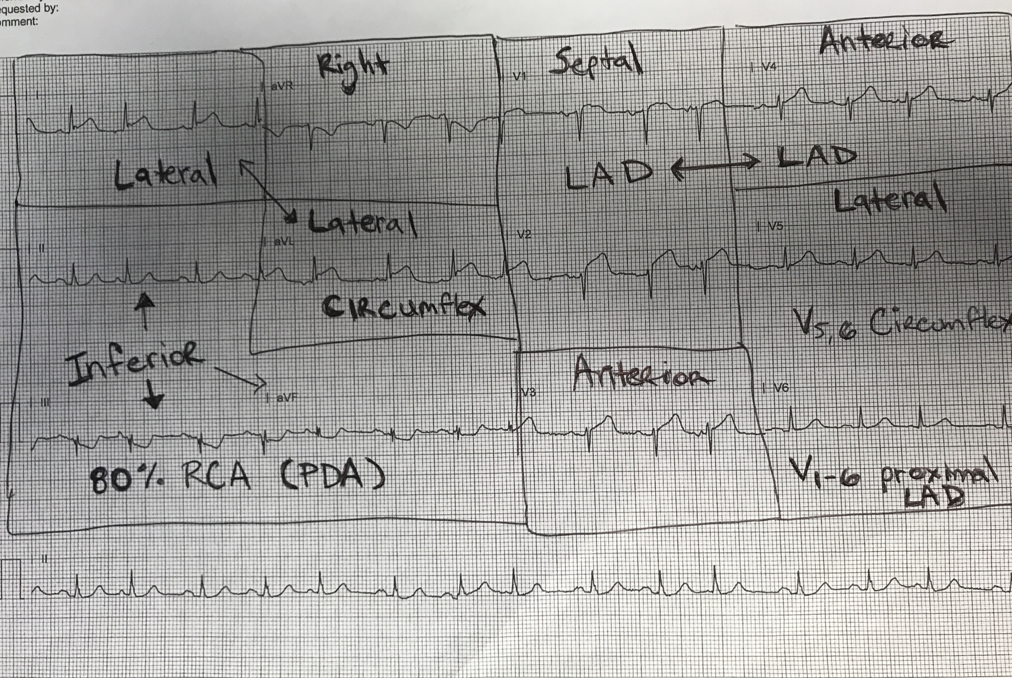
Clinical Features: Acute Coronary Syndrome
ST-elevation Myocardial Infarction (STEMI)
Definition: Strict Criteria for a STEMI
1mm Elevation in 2 contiguous leads (except anterior)
1.5-2mm in V2-3
“sheds water”
AVR is an outlier. Can have a STEMI with isolated elevation in AVR
Compare to prior EKGs
Ask for help when concerned
When troponin rules in, look at the EKG again and repeat it.

Slide 12
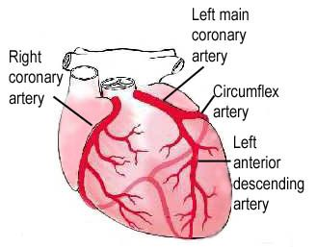
Clinical Features: Acute Coronary Syndrome
ST-elevation Myocardial Infarction (STEMI)
http://www.clevelandclinic.org/heartcenter/pub/guide/disease/cad/cad_arteries.htm

Slide 13
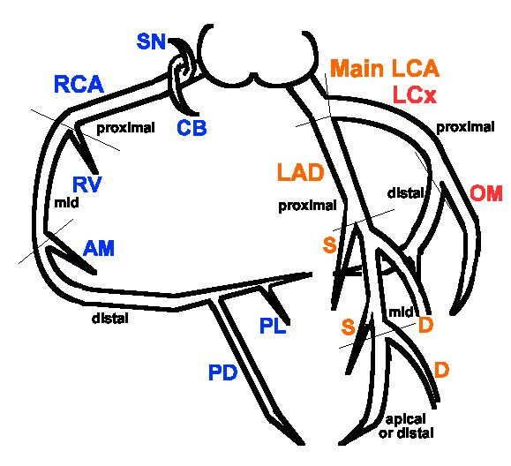
Clinical Features: Acute Coronary Syndrome
ST-elevation Myocardial Infarction (STEMI)
http://soback.kornet21.net/~heartist/coronary/cag-ori.gif

Slide 14
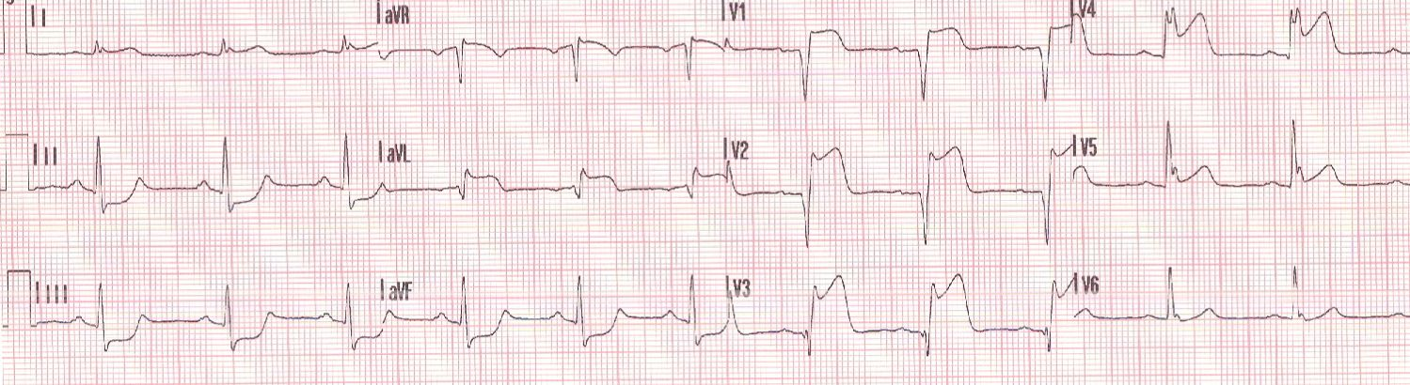
Clinical Features: Acute Coronary Syndrome
ST-elevation Myocardial Infarction (STEMI)
Treatment:
  Aspirin
  Nitrates and morphine for chest pain (use caution in setting of inferior infarction or right ventricular infarction)
  Heparin
  Emergent percutaneous intervention (Transfer to STEMI Center)
  Goal is door to balloon under 60 minutes for STEMI
  Document reason for transfer: Higher level of care for PCI
  ED to ED: call AMR and request “STEMI Interfacility transfer from referral center to STEMI receiving” and confirm code 3
  Inpatient to STEMI center: coordinate with accepting facility; house supervisor/case manager support; attempt to speak with STEMI receiving cardiologist directly.

Slide 15
Clinical Features: Acute Coronary Syndrome
Non-STEMI Management
Treatment:
  Aspirin
  Plavix
  Nitrates and morphine for chest pain (use caution in setting of inferior infarction or right ventricular infarction)
  Heparin
  Cardiology consult: not routinely obtained in the ED at RUHS
  Transfer considerations for urgent PCI:
    Dynamic EKG changes
    Intractable pain
    Recent Stent with concern for occlusion

Slide 16
Clinical Features: Acute Coronary Syndrome
PITFALLS
  Failing to explore reproducible or “atypical pain” in high risk patients
  Trusting the magic of the GI cocktail
  Epigastric pain in high risk patient
  Dyspnea in high risk or elderly patients (“Angina” literally means to suffocate/asphyxiate)
  Dismissing a newly elevated troponin as a noncardiac cause
  One troponin within 4 hours of pain
  Over-testing on low/zero risk patients
  Not comparing subtle EKG changes to prior EKGs
  Failing to obtain serial EKGs
  Psych patients (Mentally ill, in particular schizophrenics have higher incidence of ACS and yet its easy to dismiss the symptoms)

Slide 17
Clinical Features: Aortic Dissection
History (note that most patients present “atypically’)
  Pain is typically severe and maximal at onset
  Frequently described as “tearing” or “ripping”
  Radiation to the back, interscapular, or abdominal regions
  Signs and symptoms above and below the diaphragm (as dissection may progress in any direction)
  Chest pain with neurologic symptoms (Think Dissection!)
Physical examination may reveal
  Jugular venous distension from cardiac tamponade
  Hypertension and possible blood pressure (differential > 20 mm Hg) and pulse differences between upper extremities
  Aortic regurgitation murmur

Slide 18
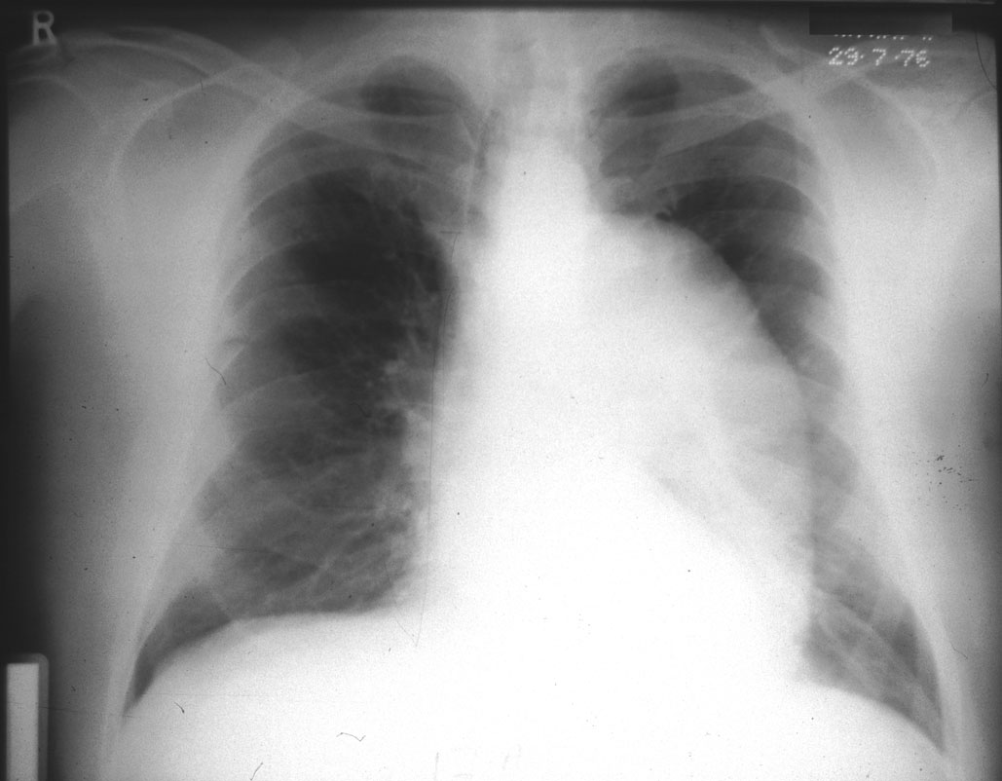
Clinical Features: Aortic Dissection
Chest radiography (CXR) may reveal:
  Widened mediastinum
  Loss of the aortic contour
  Displacement of the aorta
  Pleural effusion
Since patients may often have a normal CXR:
  CXR cannot be solely used to exclude the diagnosis
  If the history and physical findings are suggestive of aortic dissection, a CT angiogram of the chest should be obtained

Slide 19
Clinical Features: Aortic Dissection
Widened Mediastinum

Slide 20
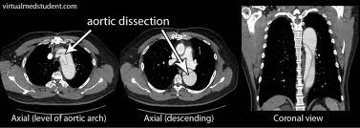
Clinical Features: Aortic Dissection on CT

Slide 21
Clinical Features: Aortic Dissection
Types:
  Ascending, descending, combined
  DeBakey Type I (ascending only), Type II (ascending and descending) and Type III (descending only)
  Stanford Type A (ascending and descending) and Type B (descending only)
Treatment:
  Blood pressure control to systolic BP of 150 with labetolol or nitroprusside and a beta blocker (do not use pure beta blocker due to theoretical risk of unopposed alpha receptor stimulation and worsening hypertension)
  Surgical consult (surgery indicated for ascending dissections)

Slide 22
Clinical Features: Pulmonary Embolism
Patients can present with:
  Pleuritic chest pain, fatigue, dyspnea, syncope, hemoptysis and/or cardiac arrest
Physician exam, EKG and CXR may be normal
Normal O₂ saturation or presence of fever does not exclude PE
Risk factors fall into one of three categories:
1. Hypercoagulable State
2. Endothelial Damage
3. Venous Stasis
Pregnancy, OCP use, cancer, recent surgery, travel, leg swelling
PERC RULE
Work up depends on risk category
Consider quantitative D-dimer testing. Useful test mainly for low risk patients
Low-risk Wells criteria patients or patients in whom ALL PERC criteria (see slide) are negative do not require additional PE work up

Slide 23
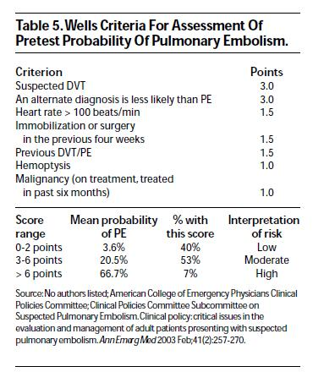
Wells Criteria

Slide 24
Clinical Features: Pulmonary Embolism
Pulmonary Embolism Rule-out Criteria (PERC):
  Hypoxia (SaO₂ < 95%)
  Unilateral Leg Swelling
  Hemoptysis
  Prior DVT or PE
  Recent Surgery or Trauma (major within 4 weeks)
  Age > 50
  Hormone Use
  Tachycardia (HR ≥ 100)

Slide 25
Clinical Features: Pulmonary Embolism
Diagnosis:
  Study of choice is CT pulmonary angiogram
  A ventilation/perfusion nuclear medicine scan can be performed if patient has contraindications to CT such as renal dysfunction or dye allergy
  In unstable patients where there is concern for a massive PE, consider lower extremity ultrasound to look for DVT and hence empirically treat for PE if US is positive
Treatment:
  Airway and hemodynamic support
  Anticoagulation with heparin or enoxaparin
  Recent literature supports outpatient treatment of select “stable” PE patients with the new class of anti-coagulants (consult physician)
  Consider thrombolysis for “massive” pulmonary embolism:
    Hemodynamic compromise
    Signs of right ventricular dysfunction on echocardiogram

Slide 26
EKG Features: Pulmonary Embolism
COMMON EKG FINDINGS:
SINUS TACHYCARDIA. (MOST COMMON, 44%)
ANTERIOR T WAVE INVERSIONS (34%)
NEW RBBB (COMPLETE OR INCOMPLETE) increased mortality
S1Q3T3 (20%)
New onset atrial tachyarrhythmias (9 %)
  https://lifeinthefastlane.com/ecg-library/pulmonary-embolism

Slide 27
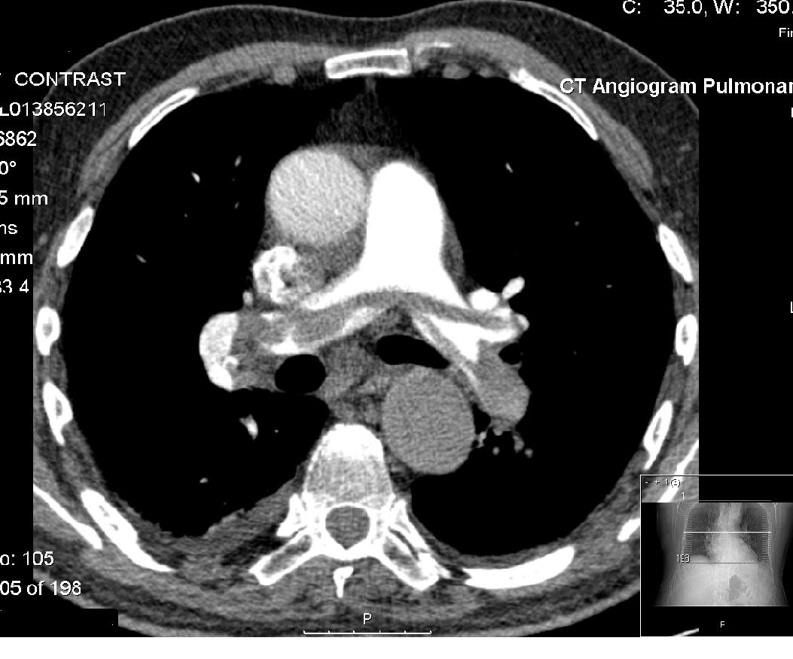
CT Angiogram Demonstrating a Saddle Embolus

Slide 28
Clinical Features: Pulmonary Embolism
  HIGH YIELD PE PEARLS
  DYSPNEA AND SYNCOPE THINK PE
  MIND THE EKG → RIGHT HEART STRAIN
  POCUS → RV DILATATION
  CONSDIER EARLY ANTICOAGULATION IN HIGH RISK PATIENTS (TREATMENT IN IGNORANCE)

Slide 29
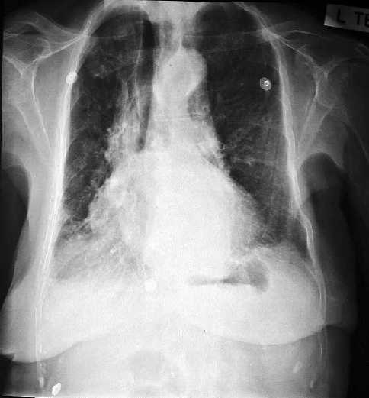
Clinical Features: Esophageal Perforation
Classic History
  Vomiting followed by severe chest pain, shortness of breath, subcutaneous emphysema. (More common amongst alcoholics)
  Rapid circulatory collapse not always present
Some patients have no history of vomiting
Physical Exam:
  Diminished breath sounds, heart sounds with audible crepitus (Hamman’s crunch), or subcutaneous air in thorax or neck
Chest X-ray: Pneumomediastinum, hydro-pneumothorax, pleural effusion or mediastinal widening
Confirmatory Studies: Contrast esophagram, CT scan, or endoscopy

Slide 30
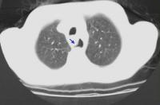
Clinical Features: Esophageal Perforation
CT Findings (non-enhanced) of esophageal rupture
  Extraluminal air in the mediastinum or surrounding the esophagus is the most reliable sign and, when taken in conjunction with the clinical presentation, has a 92% accuracy
  Gas may appear as a single or multiple discrete collections, particularly with mediastinal abscess formation
  Air fluid levels may also be seen within mediastinal abscesses
  False tract emanating from the esophagus:
Treatment:
  High mortality condition
  IV hydration
  IV pain control
  Broad spectrum antibiotics
  Emergent surgical consultation for surgical repair

Slide 31
Clinical Features: Pneumothorax
History:
  Chest pain and shortness of breath
  Pain is sudden, sharp and pleuritic in nature
  Pay special attention in patients with advanced emphysema and tall/thin patients
Physical Exam:
  Diminished or absent breath sounds
  Deviated trachea
  Chest hypertympanic to percussion
Upright and expiratory CXR is more sensitive
Bedside ultrasound can also be used to diagnose a pneumothorax
  http://sinaiem.us/tutorials/pneumothorax
Clinical Features: Tension Pneumthorax
Caused by massive and sudden accumulation of air in the pleural activity
Signs and symptoms include severe shortness of breath, decreased unilateral breath sounds, tracheal deviation to the opposite side and possible hypotension
Diagnosis is clinical! (Do not delay by obtaining x-ray)
Treatment is rapid evacuation of air with needle thoracostomy followed by chest tube insertion

Slide 32
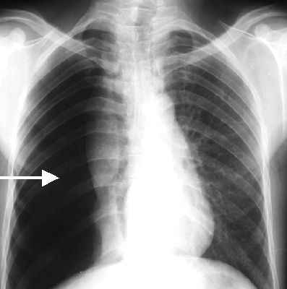
Clinical Features: Pneumothorax
Treatment:
  Support airway and oxygenation
  Observation for select small pneumothoraces
  Remove pleural air:
    Needle aspiration
    “Pigtail” catheter placement
    Chest tube placement
    Consult physician for best option

Slide 33
Clinical Features: Acute Pericarditis
History:
  Chest pain radiating to the back, neck or shoulders
  Worsens with inspiration; improved while sitting up and leaning forward
  Usually seen in younger age group
Physical Exam:
  May reveal jugular venous distension, muffled heart sounds, hypotension or tachycardia (cardiac tamponade)
  Friction Rub (rare)
Classical ECG Findings:
  Diffuse concave ST segment elevation, T-wave inversions, and PR-segment depression
  Not distributed in distinct anatomic regions

Slide 34
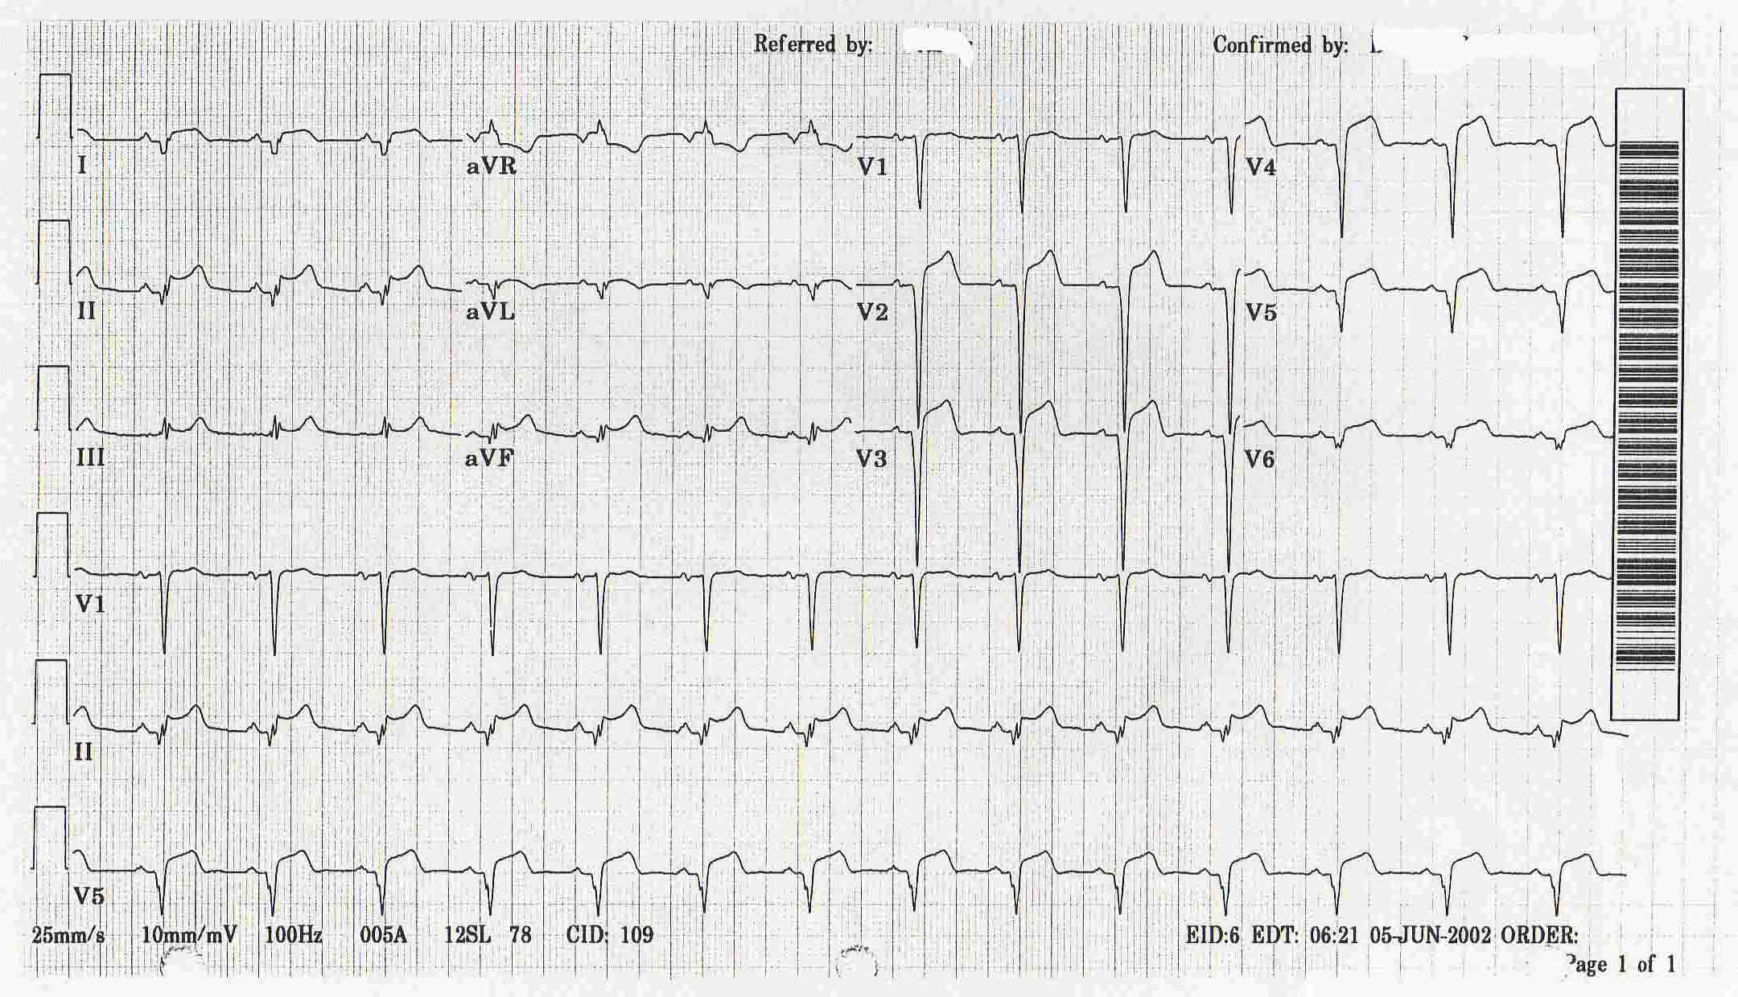
Clinical Features: Acute Pericarditis
Treatment:
  NSAID’s
  Possible narcotic analgesics
  Consider IV antibiotics for purulent pericarditis
  Consider pericardiocentesis if patient is displaying hemodynamic compromise or signs of cardiac tamponade:
    Consult ED physician, cardiology or cardiothoracic surgery
    Aggressive IV hydration

Slide 35
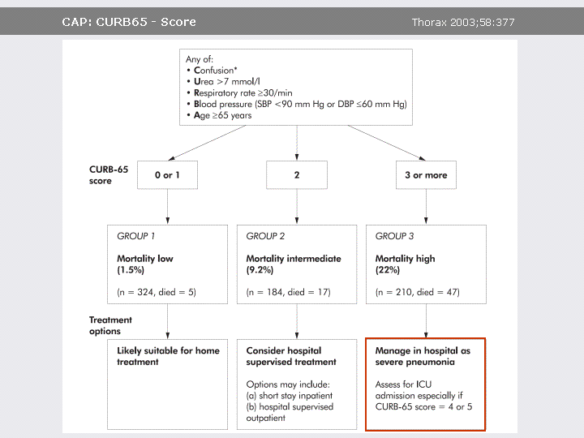
Clinical Features: Acute Pneumonia
Wide range of pain from sharp and pleuritic to dull and substernal and other associated symptoms of pneumonia
Physical examination may reveal:
    Fever
    Rales, decreased breath sounds, bronchial breath sounds
    Varying degrees of respiratory distress
CXR usually confirms the diagnosis
Patients over 65 years of age or with other co-morbidities (diabetes, CHF, kidney disease, liver disease, cancer, etc.) should be admitted
    “CURB-65” Score:

Slide 36
Clinical Features: Acute Pneumonia

Slide 37
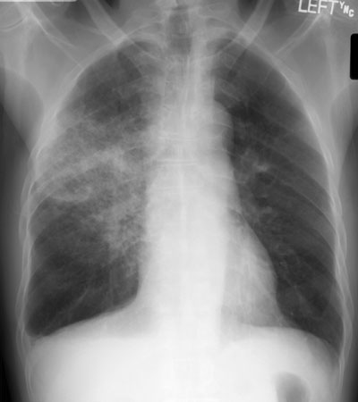
Clinical Features: Pneumonia

Slide 38
Specific Disorders
Non-Emergent Causes of Chest Pain

Slide 39
Clinical Features: Gastrointestinal Diseases
Includes gastroesophageal reflux, esophageal spasm, peptic ulcers, pancreatitis, biliary colic and cholangitis
Antacid administration can sometimes improve cardiac chest pain
Esophageal spasm and other non-cardiac disorders can improve with nitroglycerin administration
ACS should always be considered in patients suspected of having a gastrointestinal cause for their chest pain

Slide 40
Clinical Features: Musculoskeletal
Costochondritis: Inflammation of the costal cartilages producing acute, well-localized, sharp chest pain, worse with deep inspiration/movement and reproducible on palpation
  Caution: Pain may be reproducible on palpation in patient with acute MI in up to 15% of cases
Nerve root compression: Cervical or thoracic nerve compression can produce anginal type pain; worsened with neck movement, coughing or sneezing
  Applying steady pressure to the head to increase axial loading on the nerve root can reproduce symptoms (Spurling’s maneuver)

Slide 41
What You Don’t Want to Miss
Acute MI
  Sending patients home with only one set of cardiac biomarkers:
    Troponin cardiac biomarkers take 4-8 hours to peak in the setting of AMI
    Consider repeating the level in 4-6 hours from initial level, especially if pain is of recent onset
  Not repeating EKG, especially in the setting of persistent pain
  Relying on reproducible pain to rule out ACS:
    Up to 15% of ACS patients can have reproducible chest pain
Pulmonary Embolism:
  Using a normal d-dimer test to exclude pulmonary embolism in a moderate or high risk patient:
    D-dimer is only applicable to low risk patients
Pneumothorax:
  Missing pneumothorax on a supine chest x-ray:
    Upright and expiratory chest x-rays are more sensitive
    US can be used if patient cannot set up or is unstable

Slide 42
Disposition
Patients with proven or suspected aortic dissection, pulmonary embolism, esophageal perforation, pneumothorax, and acute coronary syndrome require admission to the hospital
Select patients with pneumonia or pericarditis require admission
Patients with panic disorders, chest wall pain, or nerve root compression without neurological deficit can be discharged home
Follow-up is crucial if the patient is discharged
Thorough documentation including time frame for follow up and precautionary instructions to return for must be included

Slide 43
Key Learning Points
Quality, location, onset, radiation and modifying factors are crucial in developing a focused differential diagnosis
History, physical examination and chest radiography are often useful in identifying non-ACS etiologies of chest pain
Aortic dissection and acute myocardial infarction can coexist in the same patient
A significant number of patients with acute coronary syndrome (ACS) do not have a primary complaint of chest pain: women, younger patients and the elderly can present “atypically”
Gastroesophageal symptoms are non-specific for gastrointestinal etiology and can be seen in ACS

Slide 44
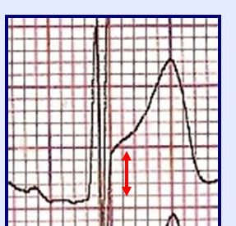
ST-Segment Elevation
BEYOND STEMI

Slide 45
Question:
The lab calls you, “Dr., how do you spell your name? Patient in Bed 15 has a Troponin of 5.”
What is your response?
Send the student to do the rectal exam
Ask the lab tech if that is an abnormal value
Attribute it to renal disease (if it was their heart they should have gone to a STEMI center)
Call hospitalist, “Bed 15 is coming in!”
Re-Look at the EKG
Call Cardiology
Order Plavix and Heparin

Slide 46
Causes of ST Elevation
1. Pericarditis
2. Prinzmetal’s Angina
3. AMI
4. LVH
5. Aneurysm
6. Conduction:
  BER, Paced, LBBB, WPW, BER, Brugada
7. Hyperkalemia

Slide 47
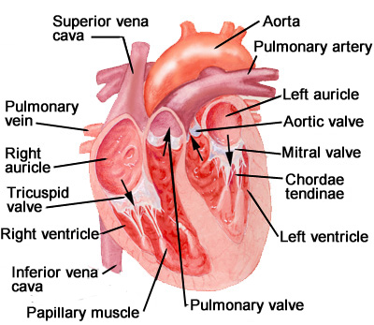
Causes of ST Elevation
1. Pericarditis
2. Prinzmetal’s Angina
3. AMI
4. LVH
5. Aneurysm
6. Conduction:
  BER, Paced, LBBB, WPW, BER, Brugada
7. Hyperkalemia

Slide 48
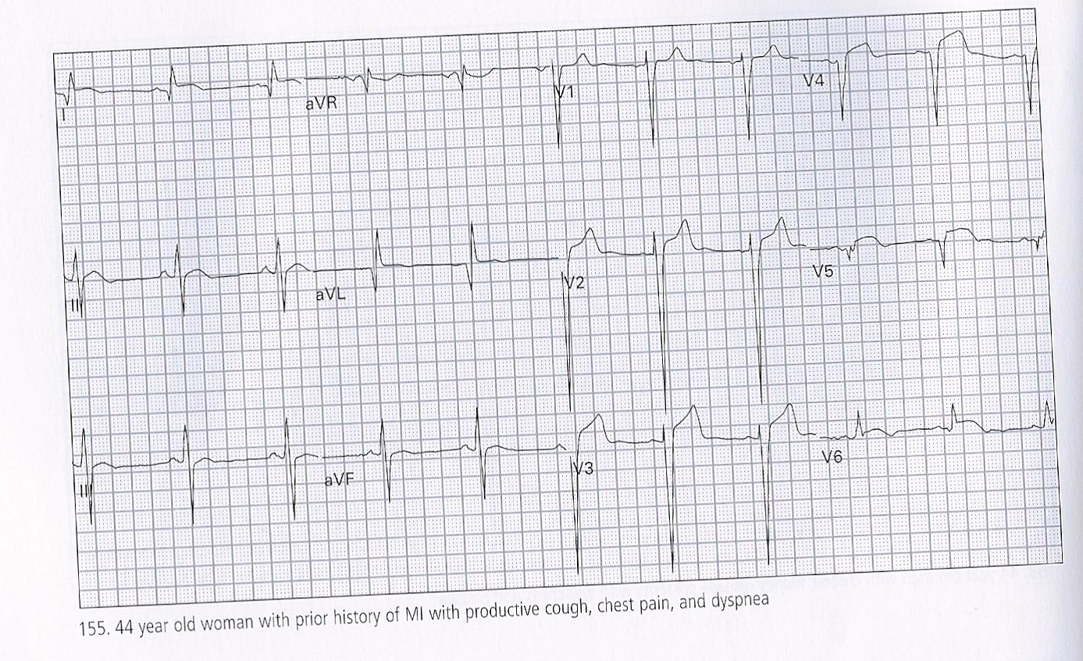
Case #1

Slide 49
Case #1: Left Ventricular Aneurysm
Q waves w/ ST-elev = MI w/ ongoing ischemia
No reciprocal changes
Large lateral q-waves & ST morphology

Slide 50
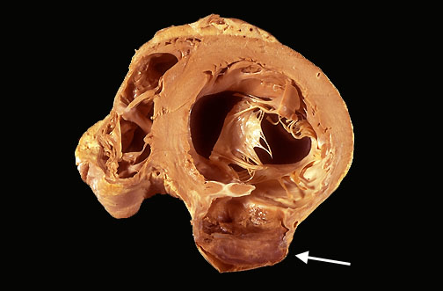
Left Ventricular Aneurysm

Slide 51
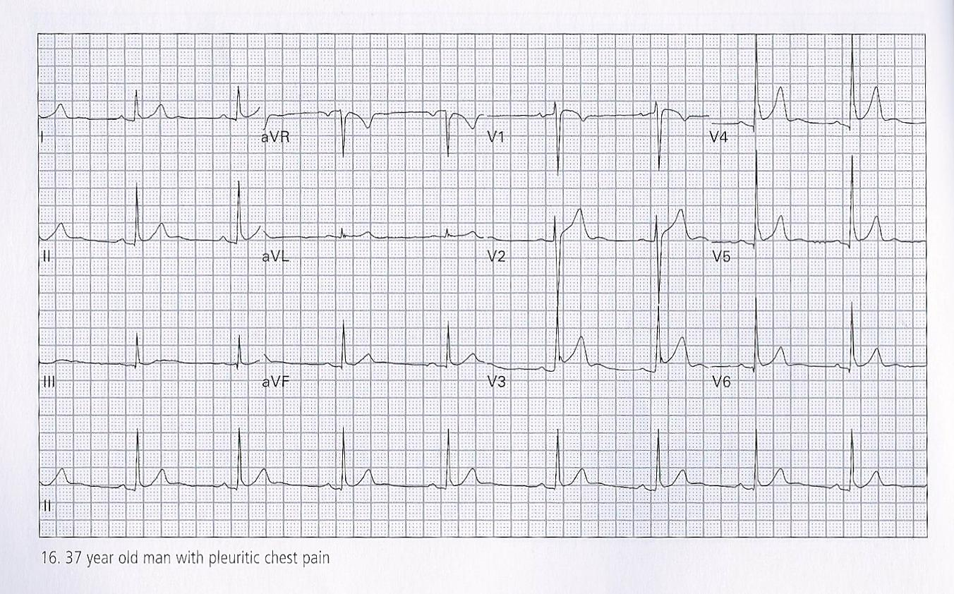
Case #2

Slide 52
Pericarditis
LVH: R in V5 + S in V1 >35 mm
Diffuse ST-elev without reciprocal changes
Subtle PR depression
Cardiac Rub **good luck**

Slide 53
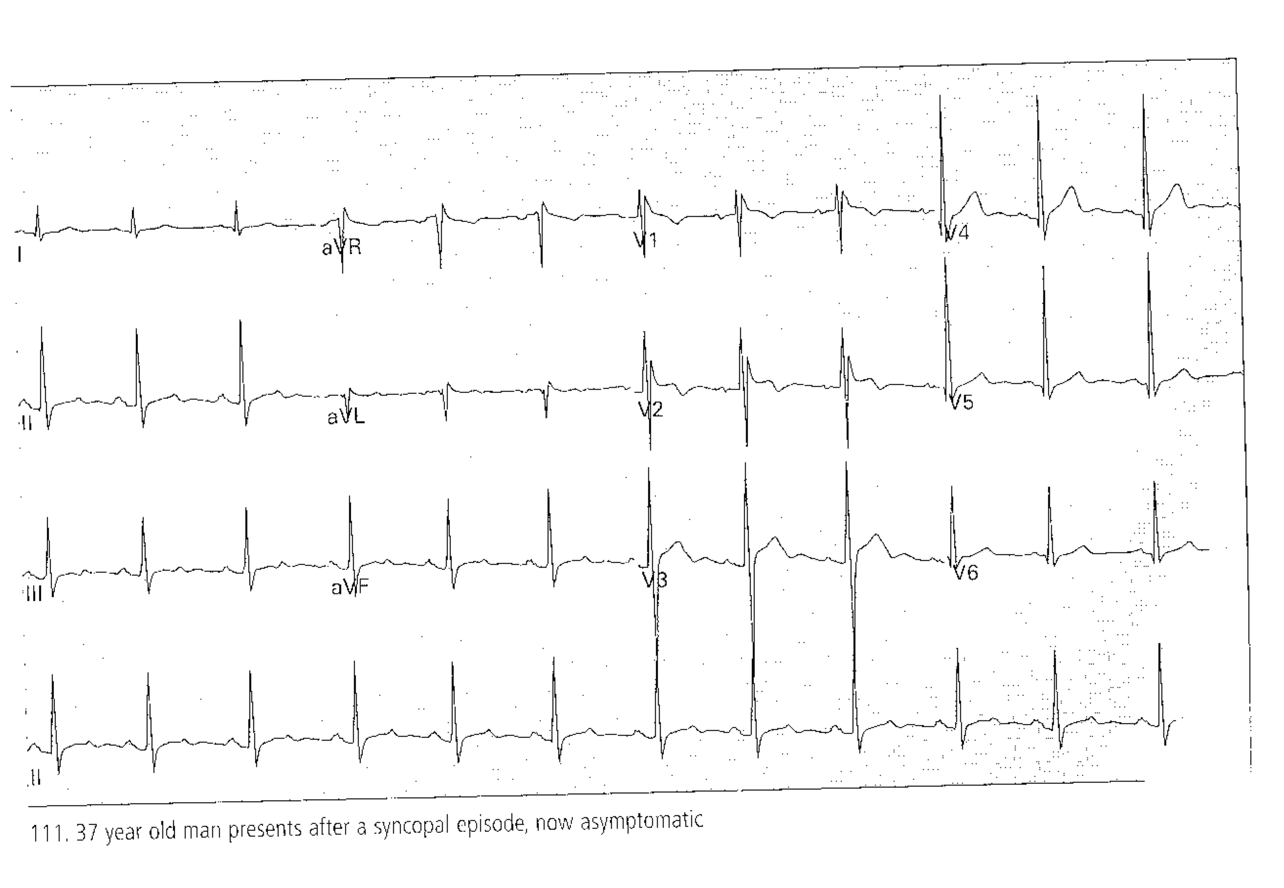
Case #3

Slide 54
BRUGADA SYNDROME
Ekg: RBB w/ ST elevation in
right pre-cordial leads
Leads to Syncope OR VTach Arrest
Dispo: EP studies & ICD
Missed: 10% per year mortality

Slide 56
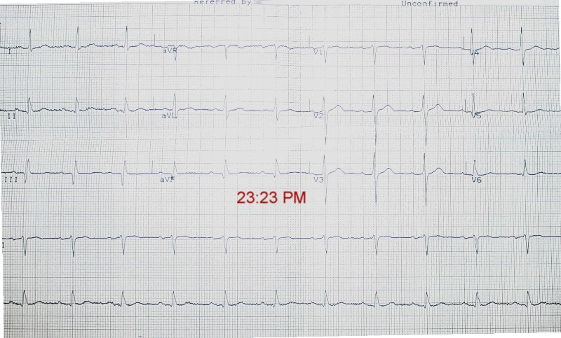
Case #4

Slide 57
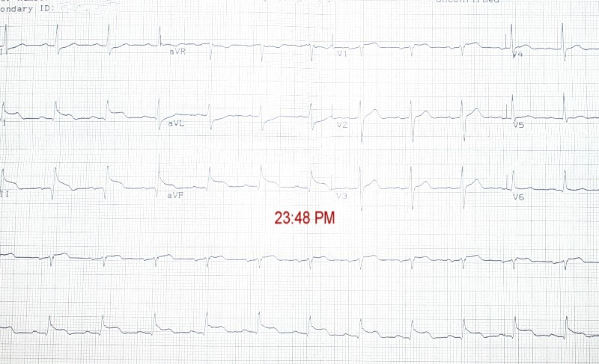
Case #4

Slide 58
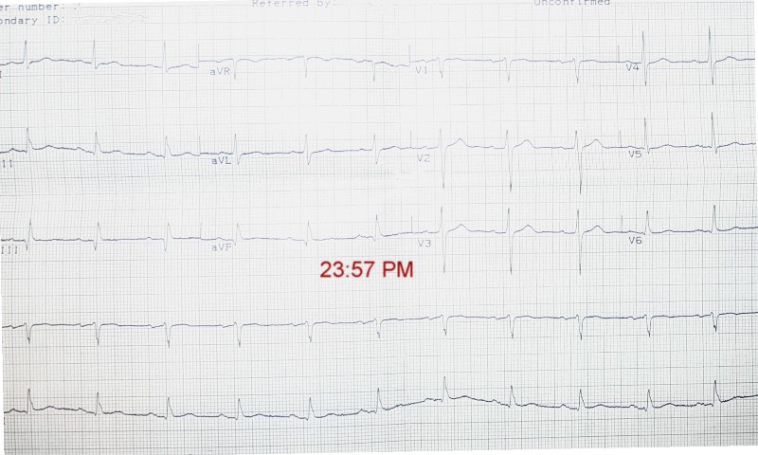
Case #4

Slide 59
Case #4
Prinzmetal’s Angina
2-3 mm ST-elev inferior, reciprocal depression in I and AVL
Typically have pain at Rest not exertion
Diagnosis by Angiogram!!

Slide 60
Case #5:
A 62 y.o. Hispanic male with DM, HTN, presents to the emergency department with 45 minutes of mid chest pressure. He is diaphoretic and in moderate distress.
BP 175/96, HR , RR 34, O2 sat 98% on 2L.
His EKG:

Slide 61
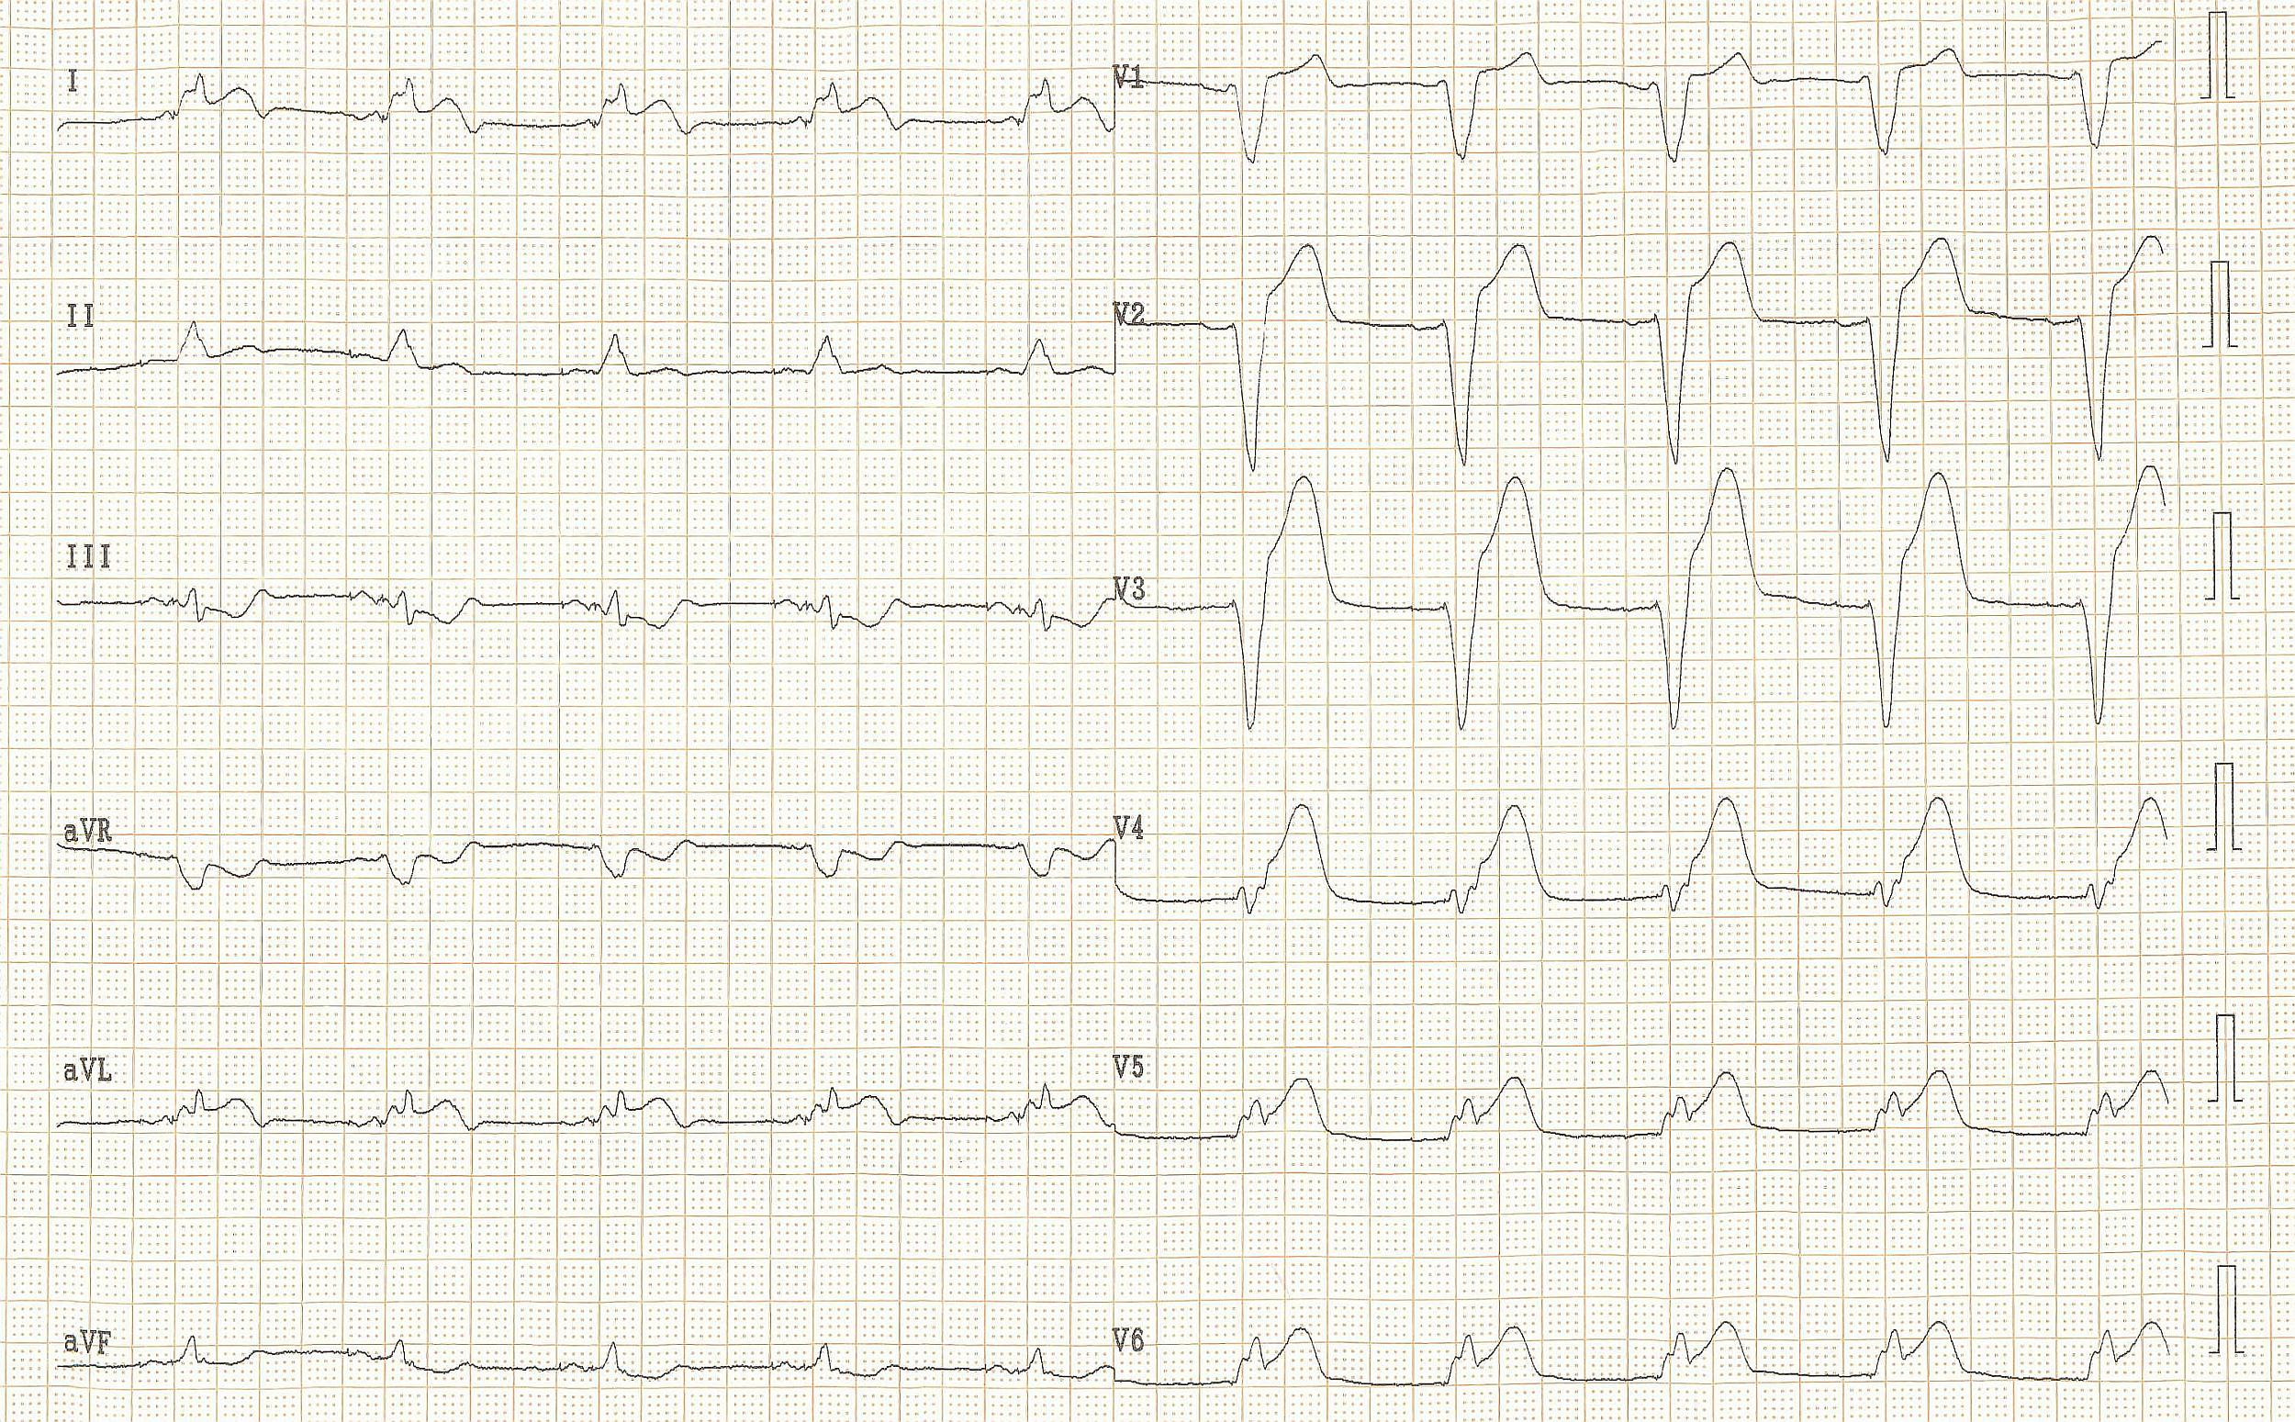

Slide 63
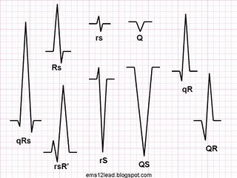
QRS Nomenclature
Terminal
Deflection
is the
Main
Deflection

Slide 64
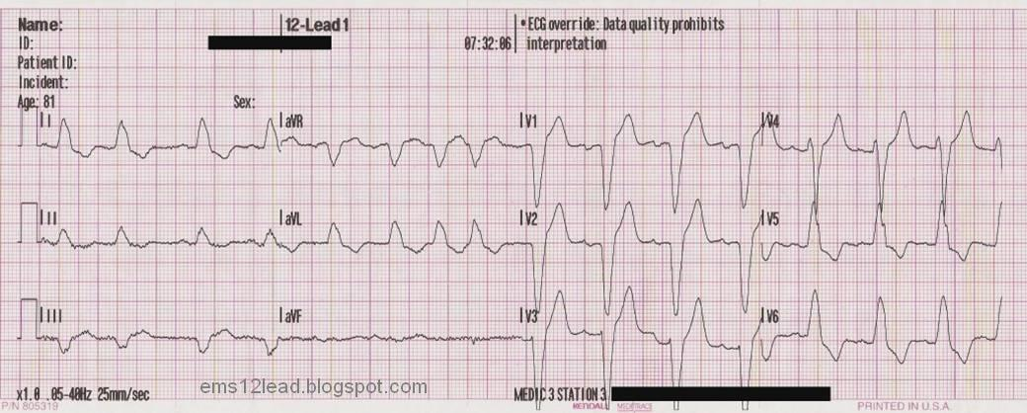
Normal LBBB

Slide 65
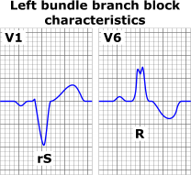
Normal LBBB
LBBB criteria:
The heart rhythm must be supraventricular in origin
QRS duration must be = or > 120
QS or rS in V1
Monophasic R in Lead I and V6

Slide 66
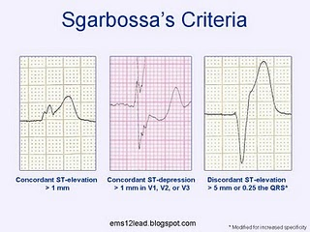

Slide 67
1.) ST segment elevation = or > 1 mm that is concordant with the QRS complex.
2.) ST segment depression = or > 1 mm in leads V1, V2, or V3.
3.) ST segment elevation = or > 5 mm that is discordant with the QRS complex.

Slide 68
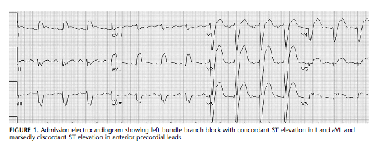
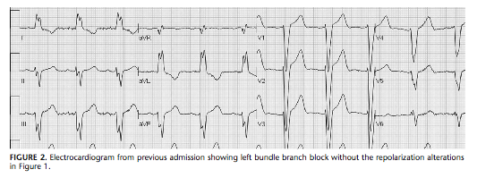

Slide 69
Case #5: Sgarbossa Criteria
A patient is presumed to be experiencing an evolving AMI if any of the following are present.
1.) ST segment elevation = or > 1 mm that is concordant with the QRS complex.
2.) ST segment depression = or > 1 mm in leads V1, V2, or V3.
3.) ST segment elevation = or > 5 mm that is discordant with the QRS complex.

Slide 70
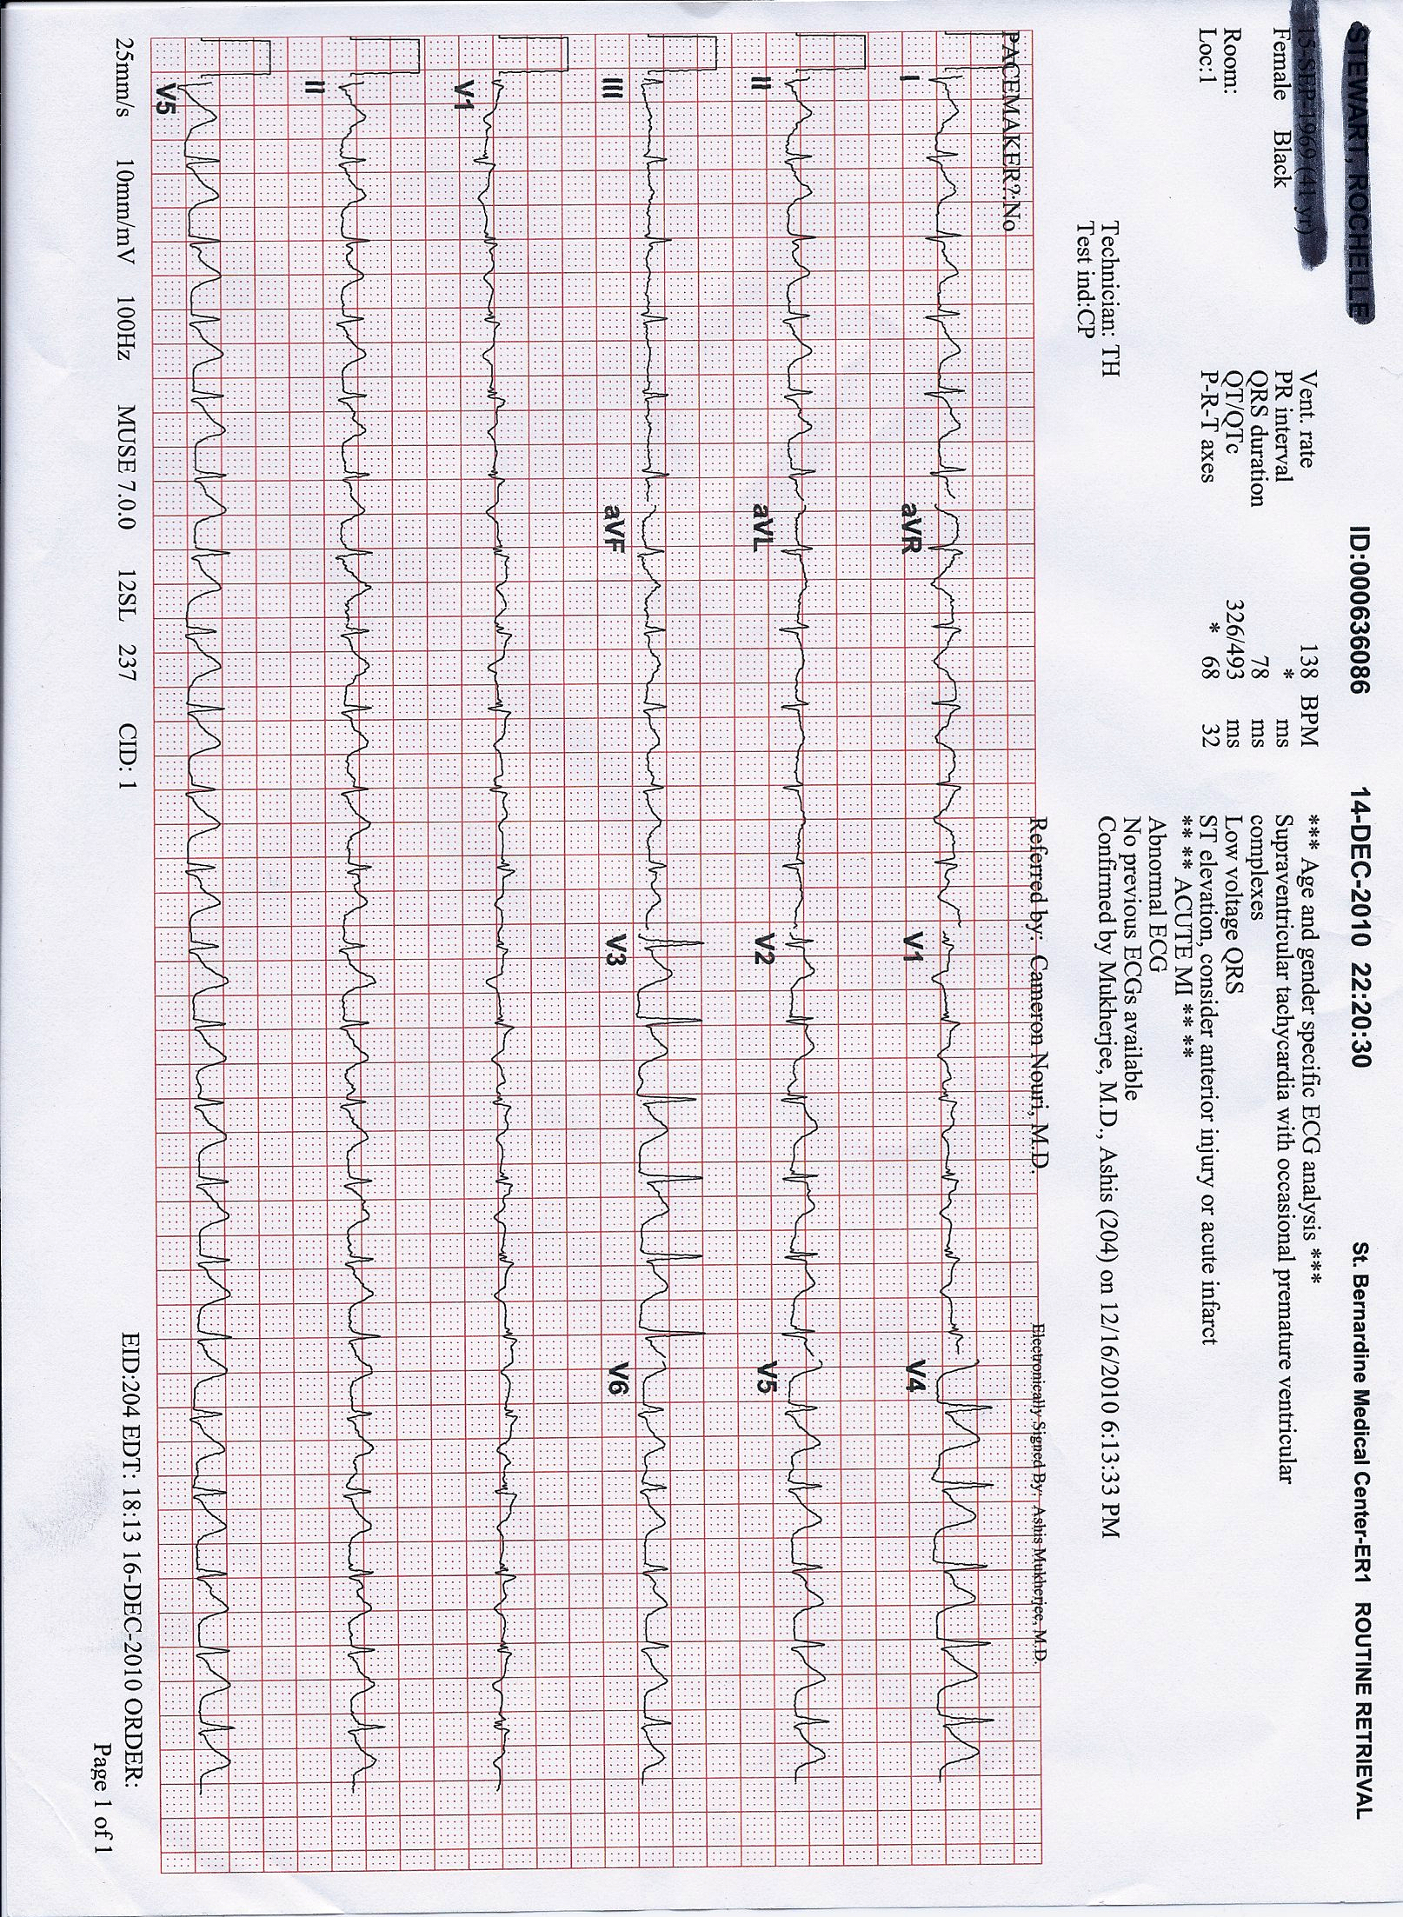
Case #6

Slide 71
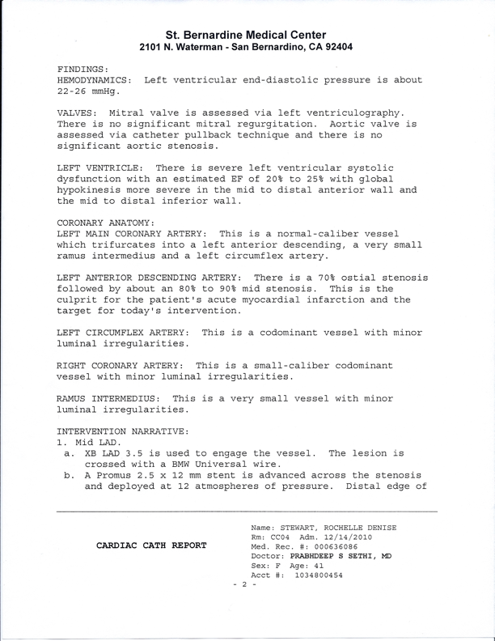
Case #6
STEMI

Slide 72
Causes of ST Elevation
1. Pericarditis
2. Prinzmetal’s Angina
3. AMI
4. LVH
5. Aneurysm
6. Conduction:
  BER, Paced, LBBB, WPW, BER, Brugada
7. Hyperkalemia

